Slide 1
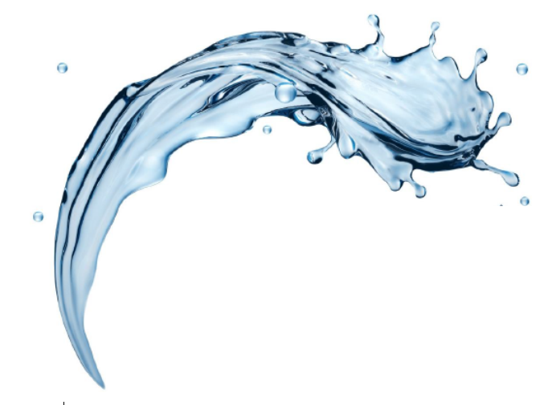
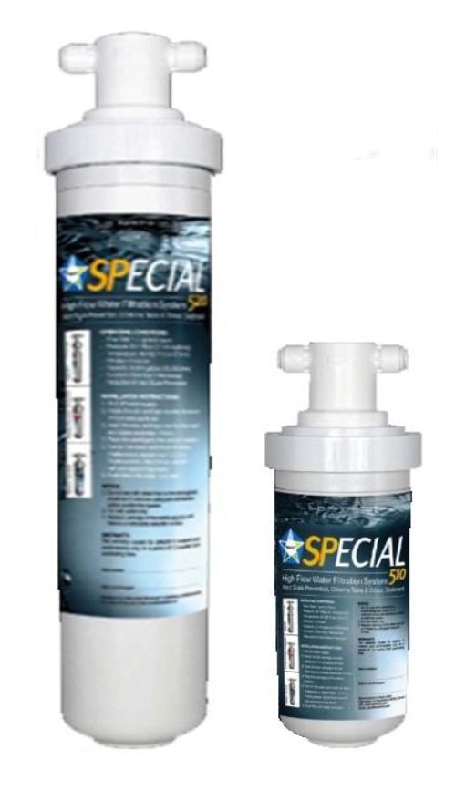

Special
Oxygenized Drinking Water
Special Water is made by
Special Filter dissoliving a high
concentration of Oxygen in
Natural Tap Water using the
Mineral known as
TemporaryWater Hardness
-by Deepak Chopra

Slide 2


What is SPECIAL Water?
The term SPECIAL Water is just to Label used to describe ideal drinking water as provided by Nature
Ca(HCO₃)₂ → CaCO₃ + H₂O + CO₂ ↑
All NATURAL Water Consisting of H₂O molecules and OH- and H+ ions in very small quantities. These are ions that give acidity and alkalinity to water. When these ions are equal in number, the water is NATURAL and NEUTRAL. When any other Ion whether its CATION or ANION is added to water its not natural anymore. H+ ions addition makes the water ACIDIC while OH- ions make the water more ALKALINE.

Slide 3
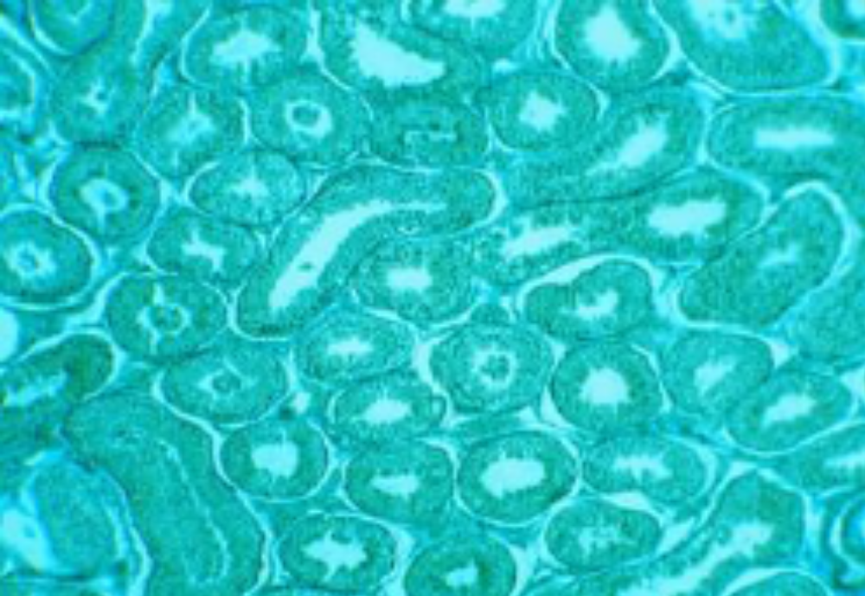
What is SPECIAL Water?
NOW TRY TO UNDERSTAND...
OH⁻ Water has more Oxygen and alkaline minerals (Calcium and Magnesium) described as CaCO₃ equivalent than Natural drinking water or ACIDIC and SODIUM enriched tap water, that‘s been treated with ION EXCHANGE Process.
SPECIAL Water is high oxygen content in a stable bias OH- form that is needed by all human beings cells. Each of these ions are bonded with an alkaline Calcium Carbonate minerals in very beneficial colloided form.

Slide 4
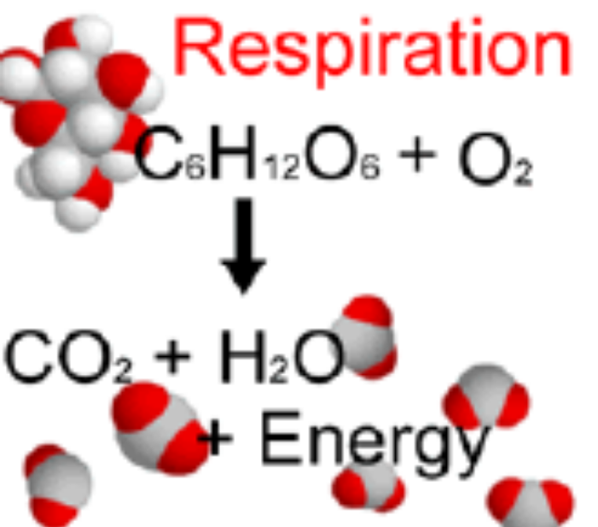
Oxygen in SPECIAL Water
Increase in free carbon dioxide (CO2) is often concomitant with decrease in Oxygen. In Natural waters as CO2 as an end product and leaves water, Oxygen content raises rapidly and at pH of 7.4 it would go up due to the release of CO2 out of the water and diffusion of Oxygen will take place. The Oxygen loading capacity is increased at low CO2 level in water.
Drinking Oxygen enriched water will be shifting oxygen to blood. Drinking high Oxygenated water will effect both metabolism and energy release and kill all depression factors related to acidic water intake.

Slide 5
pH in SPECIAL WATER
As you have already read the relation of interaction of pH and CO₂, it is the change in concentration of H⁺ ions (coupled with HCO₃ and unionized H₂CO₃) which decides the level of pH of WATER/BLOOD.
As well known fact
pH is the negative logarithm of hydrogen ion (H⁺) concentration within the pH range of 0 to 14. Every human being lives the most healthiest life at pH between 7.5 and 9, and body prefers slightly alkaline water, Beverages, Coffee and food cooked in water which is close to neutral pH. This can only be done by not exchanging Ions (unlike Ion-Exchange Resins) from Calcium and Magnesium against Hydrogen or Sodium

Slide 6
Alkalinity and Water Hardness
Alkalinity and Water Hardness are closely related. The part of total hardness chemically equivalent to total alkalinity is termed as
“CARBONATE HARDNESS”
Which is also referred as
“TEMPORARY WATER HARDNESS”
As the Carbonates Hardness are shifted from water (Scale Prevention) with
“FILTERSORB SP3”
Ca(HCO₃)₂
CaCO₃ + H₂O + CO₂
Catalytic Crystallization
CaCO₃ Crystals that cannot form scale
H₂O Becomes Neutral with keeping it’s alkalinity
CO₂ Leaves water increasing the diffusion of Oxygen into the water.

Slide 7
Permanent Water Hardness
Non-carbonate water hardness which is called „Permanent Water Hardness“ as it cannot be removed by Water-Softening or Scale Prevention system.
Permanent Water Hardness is Associated with
Sulfates (SO₄),
Chlorides (Cl),
Silicates (SiO₃),
Nitrates (NO₃) and
Phosphates (PO₄) and
NOT with
bicarbonates (HCO₃) and
carbonates (CO₃)
More on Permanent Water Hardness: Coming soon
Thanks for reading!

Slide 8
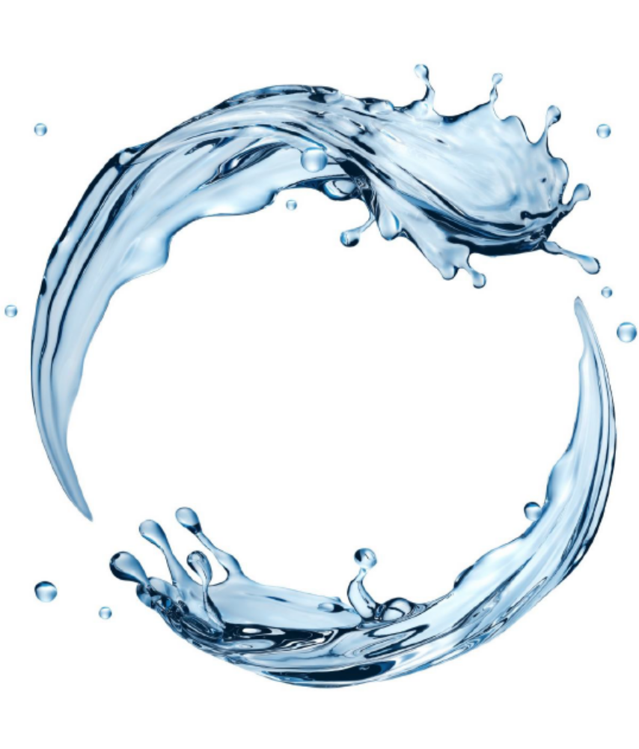

Watch Water® GmbH
Fahrlachstraße 14
68165 Mannheim
Germany
www.watchwater.de
info@watchwater.de
+49 (o)621 87951-0

